Slide 1

Intro to AI
part3

Slide 2

Recap
Deep Learning (intro, history, why it’s needed over ML, and its applications).
AI and related disciplines.
RL (Intro, how it's important to achieve AGI, examples).
Computer vision.
NLP ( intro, it's examples in the real world).
What ML can and can’t do? (examples, strengths, and weaknesses of ML).
What makes you a good data scientist?

Slide 3
Agenda
DS project workflow.
Machine Learning changing job functions.
How to work with an AI team (How communication is important between teams, working in pairs).
AI teams and roles (know what is the job profiles right there).
AI can learn unhealthy stereotypes (Bias and solutions to avoid it, how choosing data you feed into AI is critical).
How to stay updated with AI.
Success stories about women in AI or DS.

Slide 4

Data Science Pipeline

Slide 5
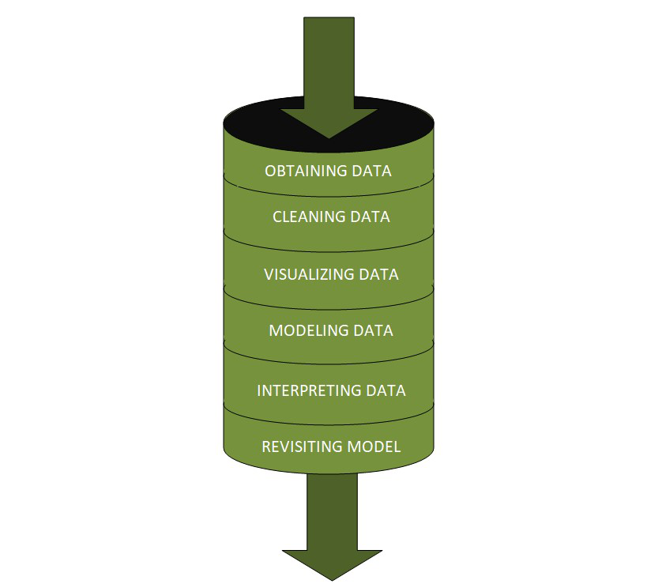
•Remember that: Data Science is a field that focuses on extracting knowledge from data sets that help businesses to take valuable data-driven decisions.
So, what is the DS pipeline (project flow)?
Let’s see this pic and then discuss each step we have separately.
Notes:
www.geeksforgeeks.org/whats-data-science-pipeline/

Slide 6
1) Fetching/Obtaining the Data
This stage involves the identification of data from the internet or internal/external databases and extracts it into useful formats. Prerequisite skills:
Database Management: MySQL, PostgreSQL, MongoDB.
Querying Relational Databases.
Retrieving Unstructured Data: text, videos, audio files, documents.
web scraping.
So, in brief, this stage is where we get (fetch) the data which we will work on.

Slide 7
2) Cleaning the Data
This is the most time-consuming stage and requires more effort. It is further divided into two stages:
1. Examining Data:
identifying errors
identifying missing values
identifying corrupt records
2. Cleaning of data:
replace or fill missing values/errors
Prerequisite skills:
Coding language: Python, R.
Data Modifying Tools: Python libs, Numpy, Pandas.
Distributed Processing: Hadoop, Map Reduce/Spark for big data.

Slide 8
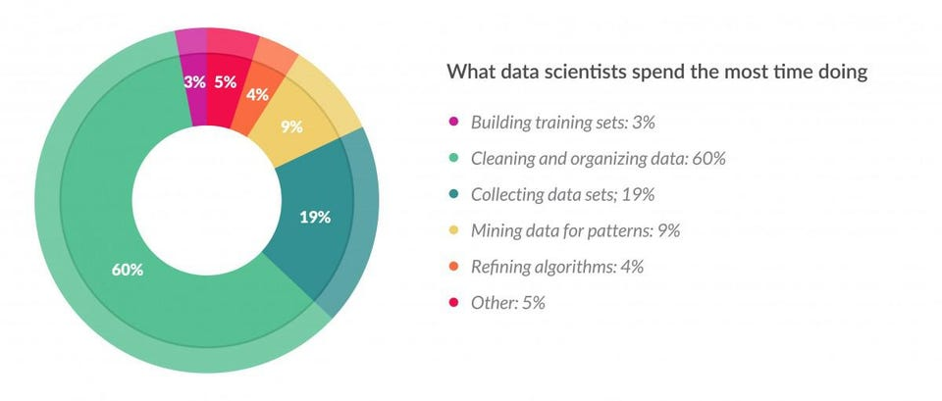
Belief this or not, the last two stages take almost 80% of the time ☺
Notes:
https://lnkd.in/gdg-sXXV

Slide 9
3) Exploratory Data Analysis (EDA)
When data reaches this stage of the pipeline, it is supposed to be free from errors and missing values, and hence is suitable for finding patterns using visualizations and charts.
Prerequisite skills:
Python: NumPy, Pandas, Matplotlib, and seaborn.
R: GGplot2.
Statistics: Random sampling, Inferential.
Data Visualization: PowerBI/Tableau.
For EDA and the pre-processing(cleaning) stage, it’s iterative. what I mean by that is sometimes you will find during the EDA process some features need some processing e.g.(normalization).

Slide 10
4) Modeling the Data
This is that stage of the data science pipeline where machine learning comes to play. we create data models. Data models are nothing but general rules in a statistical sense, which are used as a predictive tool to enhance our business decision-making e.g. (Classification models).
Prerequisite skills:
Machine Learning: Supervised/Unsupervised algorithms.
Evaluation methods.
Machine Learning Libraries: Python (Sci-kit Learn, NumPy).
Mastering this stage will take you months or even years but when you come to apply it(coding part), praise the contribution and the availability of programming languages and frameworks we have, it becomes like a piece of cake.

Slide 11
5) Interpreting the Data
Always remember, if you can’t explain it to a six-year-old, you don’t understand it yourself. So, communication becomes the key!!
This is the most crucial stage of the pipeline, where with the use of psychological techniques, correct business domain knowledge, and storytelling abilities, you can explain your model to a non-technical audience.
Prerequisite skills:
Business domain knowledge.
Data visualization tools: Power BI, Tableau, Matplotlib, ggplot2, and Seaborn.
Communication: Presenting/speaking and reporting/writing.
We already emphasized this part in the last class at the core skills part.

Slide 12
Data science is not about great machine learning algorithms, but about the solutions which you provide with the use of those algorithms. DS is a mindset. It is also very important to make sure that your pipeline remains solid from start till end, and you identify accurate business problems to be able to bring forth precise solutions.

Slide 13
Machine Learning changing job functions
Sales
Identifying sales opportunities
Prioritizing
Manufacturing line manager
Optimize manufacturing
Machine learning can spot defects
Recruiting
Identify how people prefer recruitment
Spot good candidates
Marketing
A/B testing
Recommendation system.
And much more fields where AI can change it, and take these jobs to disappear, too.
Let's check this site! (will robots take my job)

Slide 14
How to work with AI team (You will never walk alone)
Specify your acceptance criteria
95% accuracy!
Training, validation and Test dataset!
Don’t expect 100% accuracy:
Limitations of ML
Insufficient data
Mislabeled data
Ambiguous labels (human perception)

Slide 15
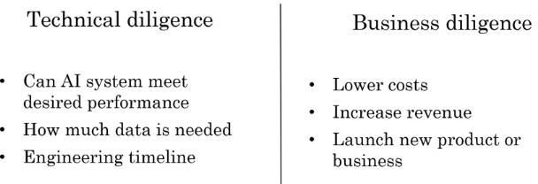
As A Team You need!

Slide 16
AI teams
AI team may have 100s of engineers
A small team can have four or five members
Example roles
Software Engineers
Execute joke, Set timer
Machine Learning Engineer
Machine Learning Researcher
Extend state-of-the-art
Applied ML scientist in between ML researcher and ML Engineer
Data Scientist
Provide insights

Slide 17
AI teams, Cont.
Data Engineer
Organize data
Data is saved in cost effective way
We have lot of data, scalability is important
AI Product Manager
What to build and feasible
What is required from this job profiles is really differs over time, so it's needed to be updated with it.

Slide 18
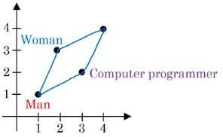
AI can learn unhealthy stereotype
Learn from internet
Man: Woman as Father: Mother
Man: Woman as King: Queen
Man : Computer programmer as women: Home maker
Man and woman can equally become programmer

Slide 19
Why bias matters
Hiring tool that discriminates against woman
Facial recognition working better for specific ehtnicity
Bank loan approavals
Toxic effect of reinforcing unhealthy stereotypes

Slide 20

How to stay updated with AI

Slide 21
AI is always changing with news, trends, innovations, and inventions to stay current on.
Staying up-to-date is worthwhile for AI professionals and enthusiasts.
Dependable Resources for AI News and Trends:
Web Discussions and Q&A Forums
Subscribing to Relevant Newsletters
Podcasts & YouTube
Webinars, Expos and Meetups
For more details, check this out: how-ai-engineers-can-stay-updated
For research papers updates, here is the most 2 useful resources I found:
papers with code
two minute papers

Slide 22

Success Stories About Women in AI or DS

Slide 23


